Slide 1



logistics_dashboard
View in Power BI
Last data refresh:
6/4/2025 5:33:52 AM UTC
Downloaded at:
6/4/2025 6:12:35 AM UTC

Slide 2
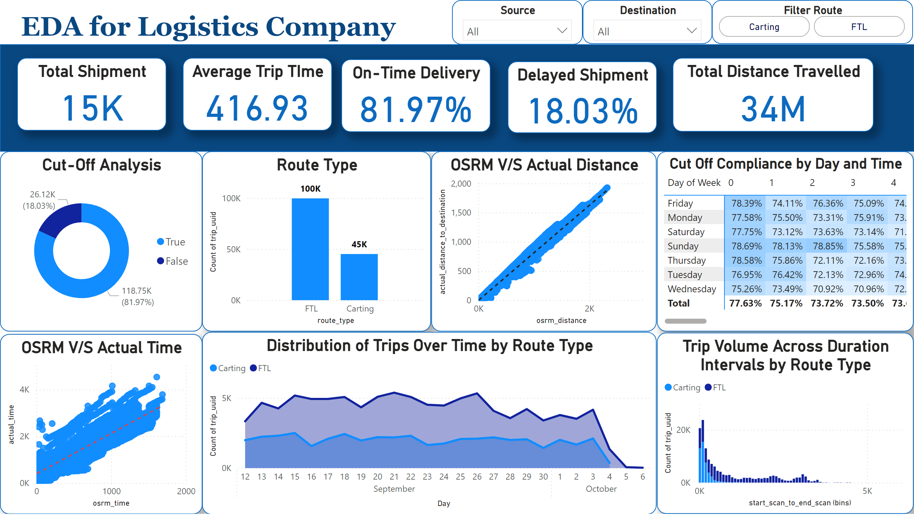
Page 1
Notes:
Total Shipment
No alt text provided
Average Trip TIme
No alt text provided
On-Time Delivery
No alt text provided
Total Distance Travelled
No alt text provided
Delayed Shipment
No alt text provided
shape
No alt text provided
Cut-Off Analysis
No alt text provided
Cut Off Compliance by Day and Time
No alt text provided
textbox
No alt text provided
textbox
No alt text provided
OSRM V/S Actual Time
No alt text provided
Route Type
No alt text provided
Trip Volume Across Duration Intervals by Route Type
No alt text provided
OSRM V/S Actual Distance
No alt text provided
Distribution of Trips Over Time by Route Type
No alt text provided
Filter Route
No alt text provided
Destination
No alt text provided
Source
No alt text provided

